Slide 1

Spring Security
JWT Authentication Architecture
Universidad de las Fuerzas Armadas - ESPE

Slide 2




Tecnologías utilizadas

Slide 3
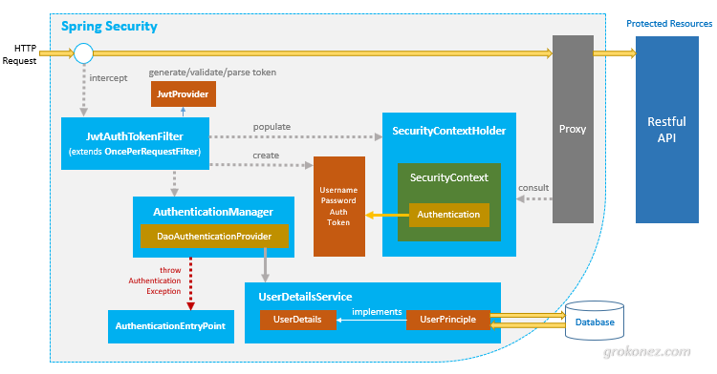

Slide 4

HTTP request, filter, authenticate, store Authentication data, generate token, get User details, authorize, handle exception

Slide 5
Referencias
https://www.toptal.com/java/rest-security-with-jwt-spring-security-and-java
https://grokonez.com/spring-framework/spring-security/spring-boot-spring-security-jwt-authentication-architecture-tutorial
https://spring.io/projects/spring-boot#overview

